Slide 2
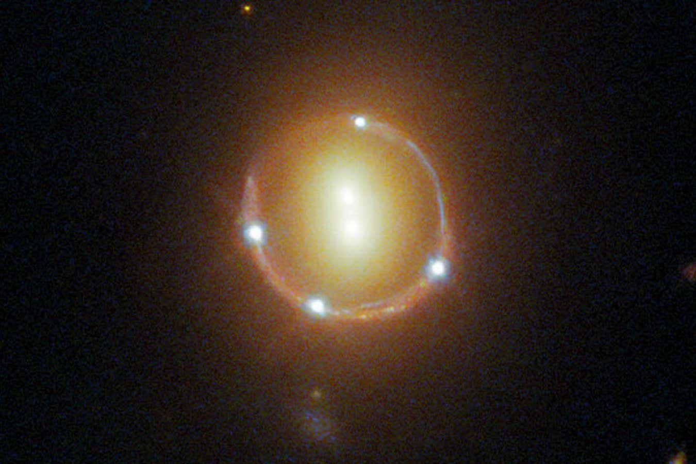

Slide 3
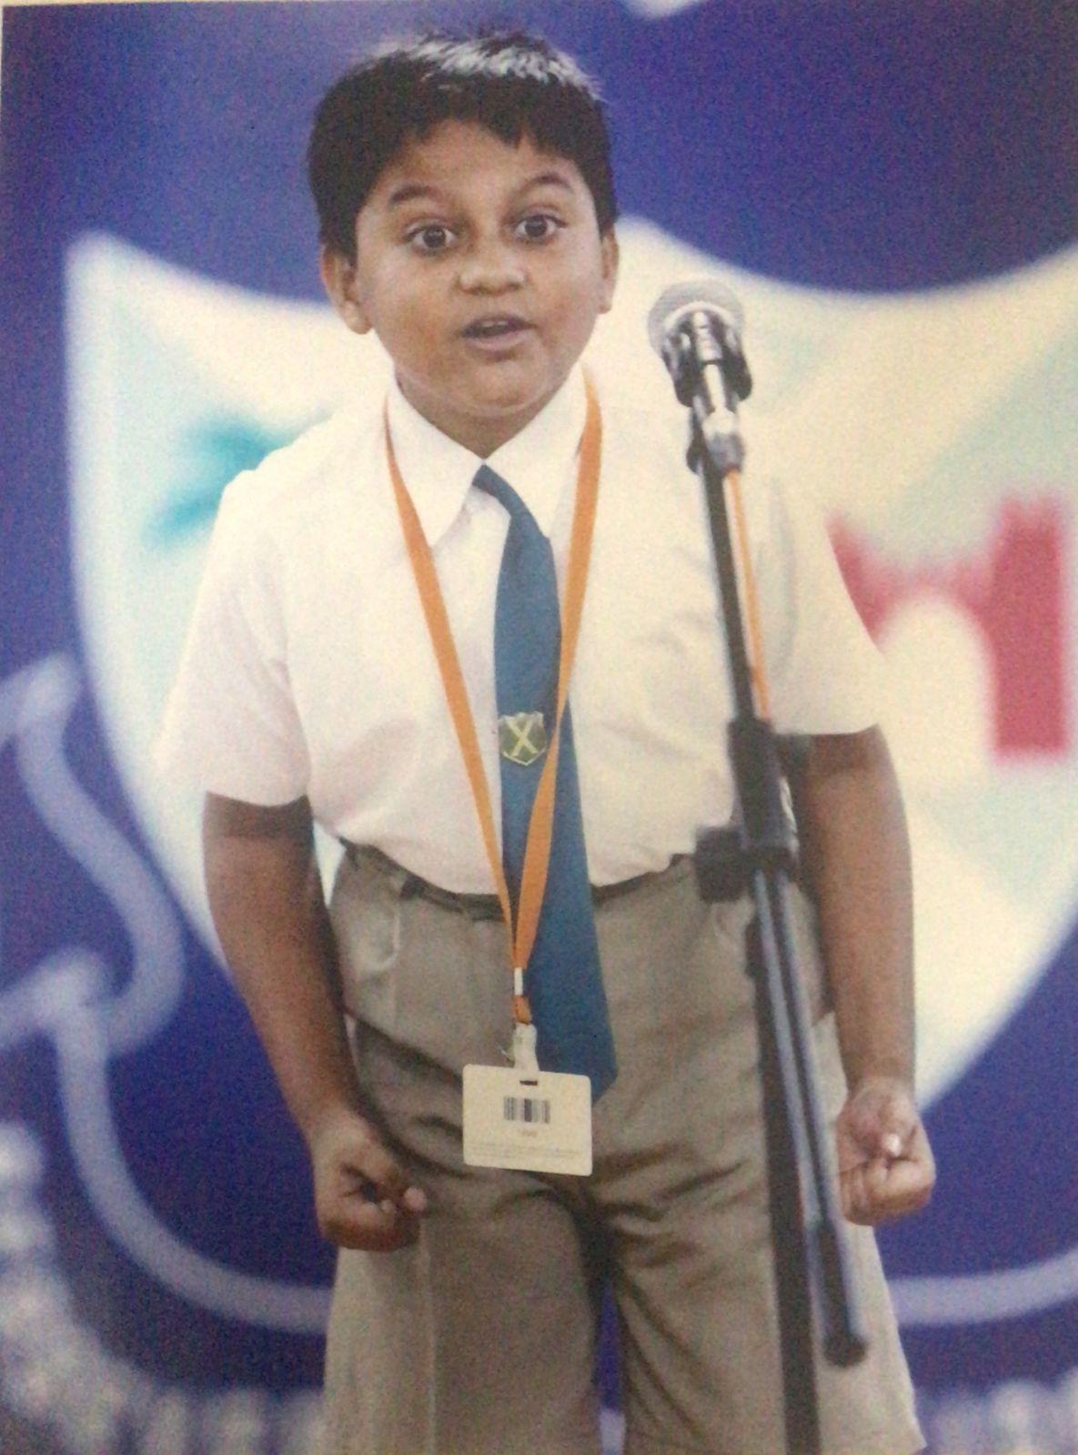
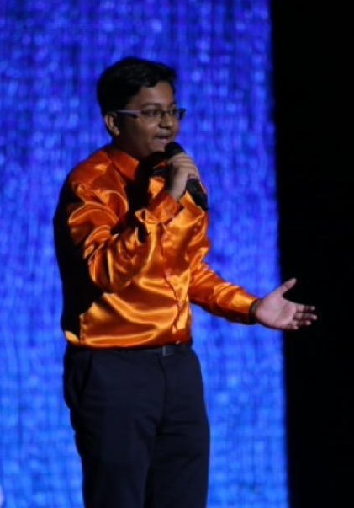

Slide 4
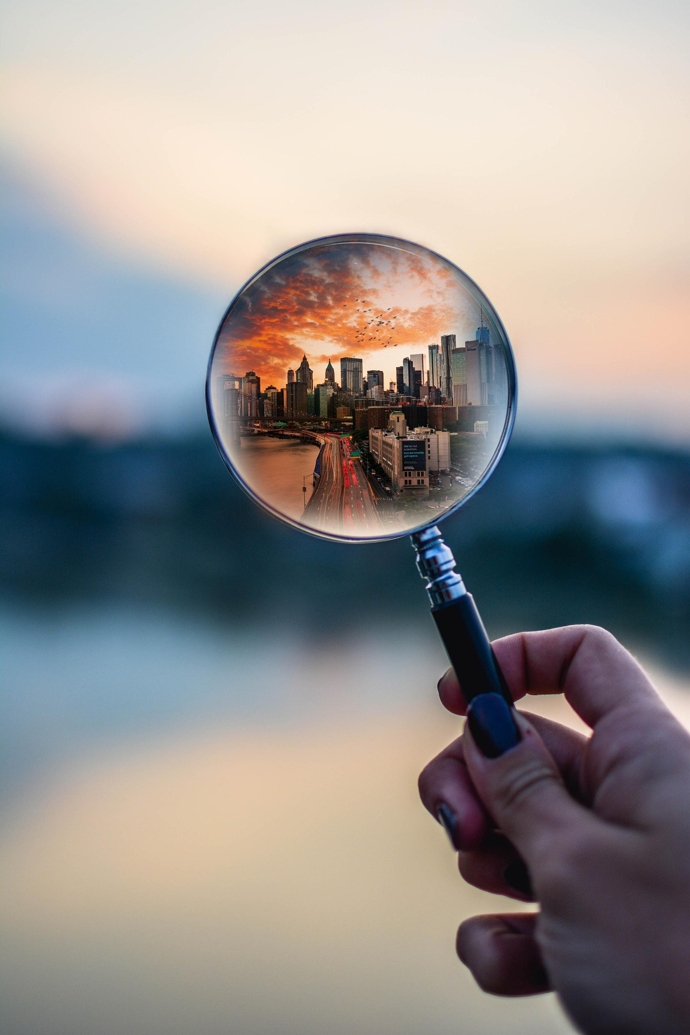
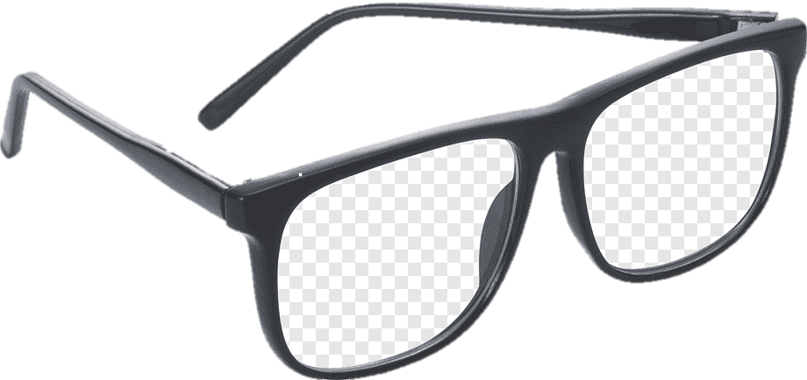
LENS
Magnification
Make Image Clearer

Slide 5
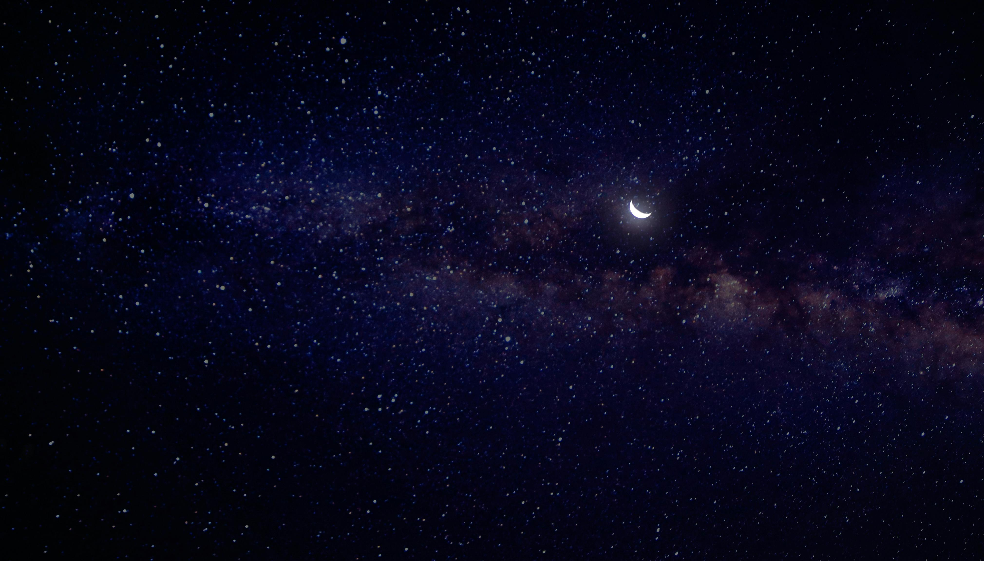
Gravitational Lens Modelling of an IllustrisTNG Mock Multiply Lensed Supernova
Rommulus Francis Lewis
Final Year Project
Supervisor: Prof Jeremy Lim

Slide 6
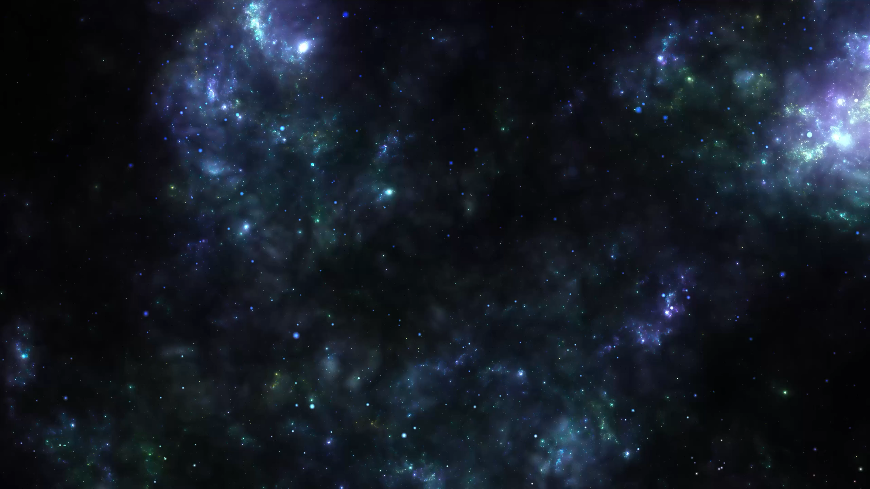
Gravitational Lens Modelling of an IllustrisTNG Mock Multiply Lensed Supernova
Rommulus Francis Lewis
Final Year Project
Supervisor: Prof Jeremy Lim

Slide 7
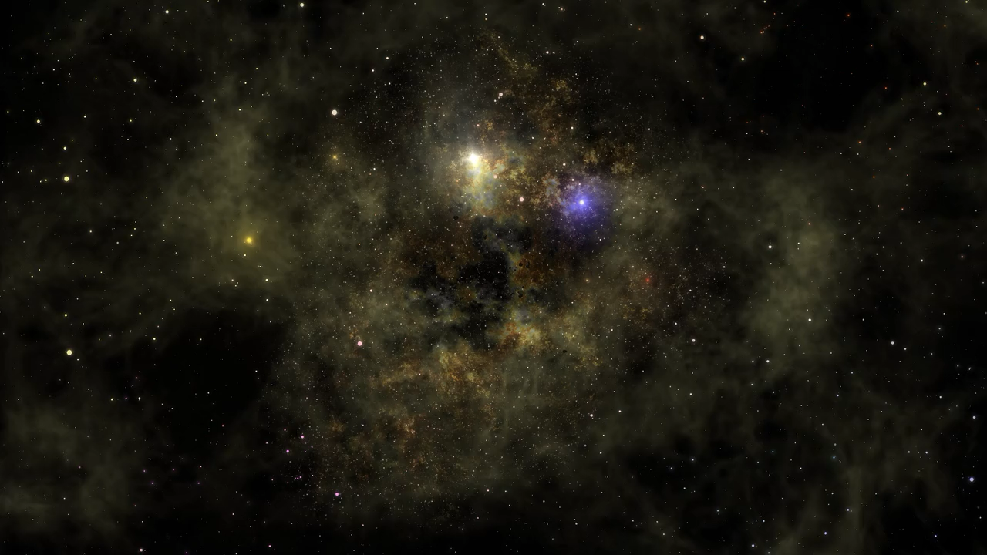
Gravitational Lens Modelling of an IllustrisTNG Mock Multiply Lensed Supernova
Rommulus Francis Lewis
Final Year Project
Supervisor: Prof Jeremy Lim

Slide 8
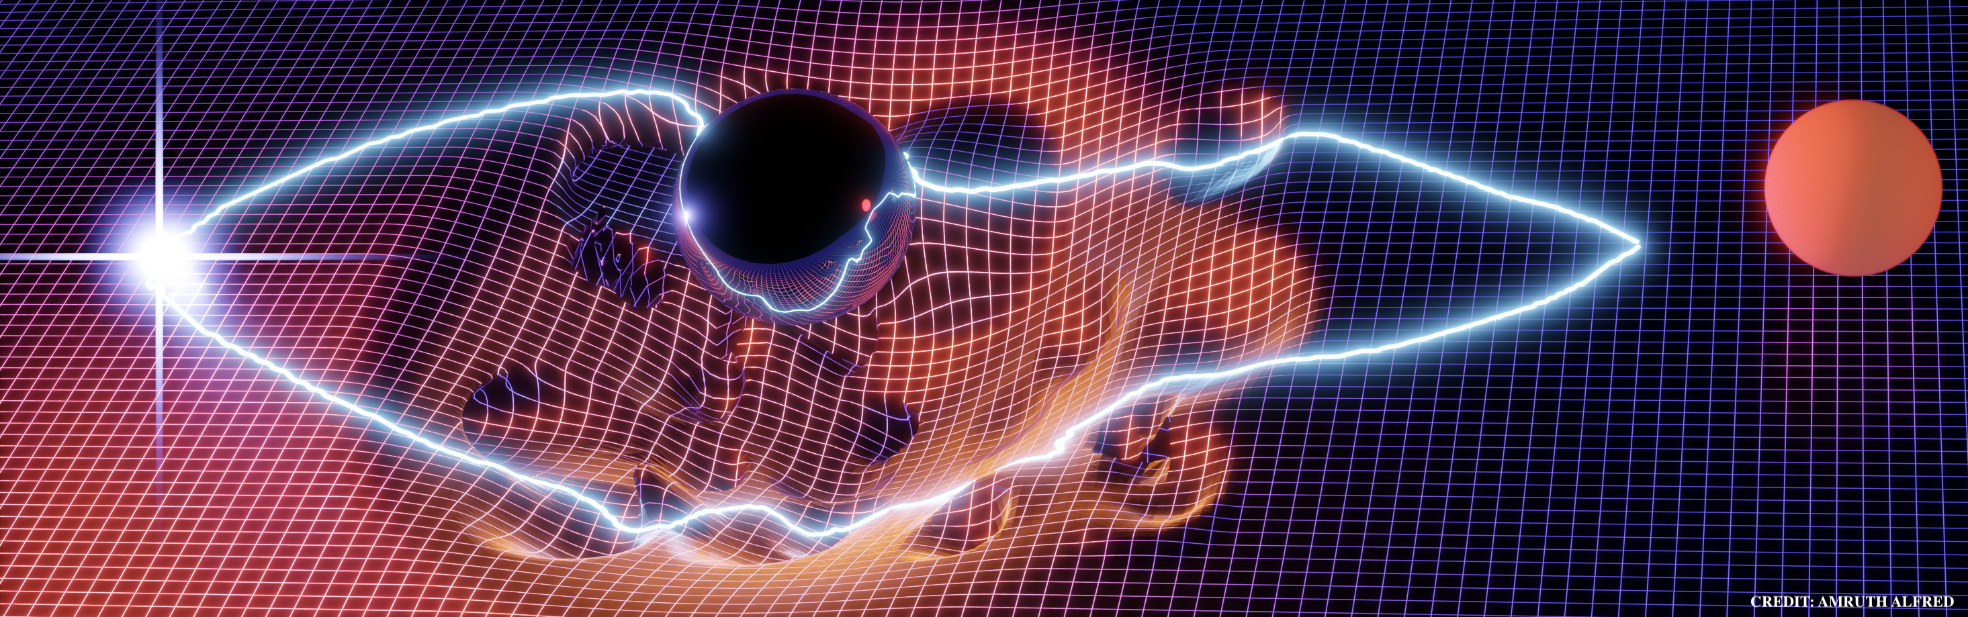
Gravitational Lensing

Slide 9
Data
Galaxy from the IllustrisTNG suite

Slide 10
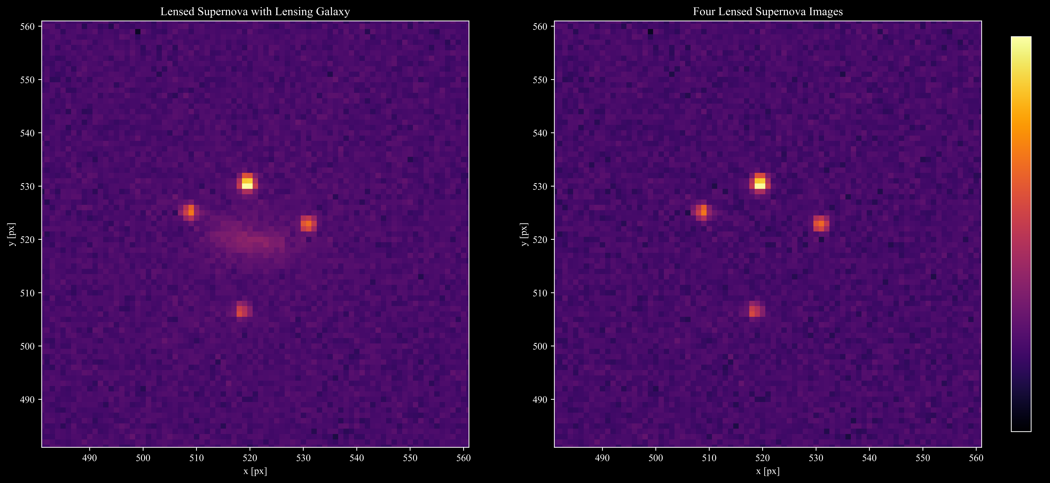
Data

Slide 11
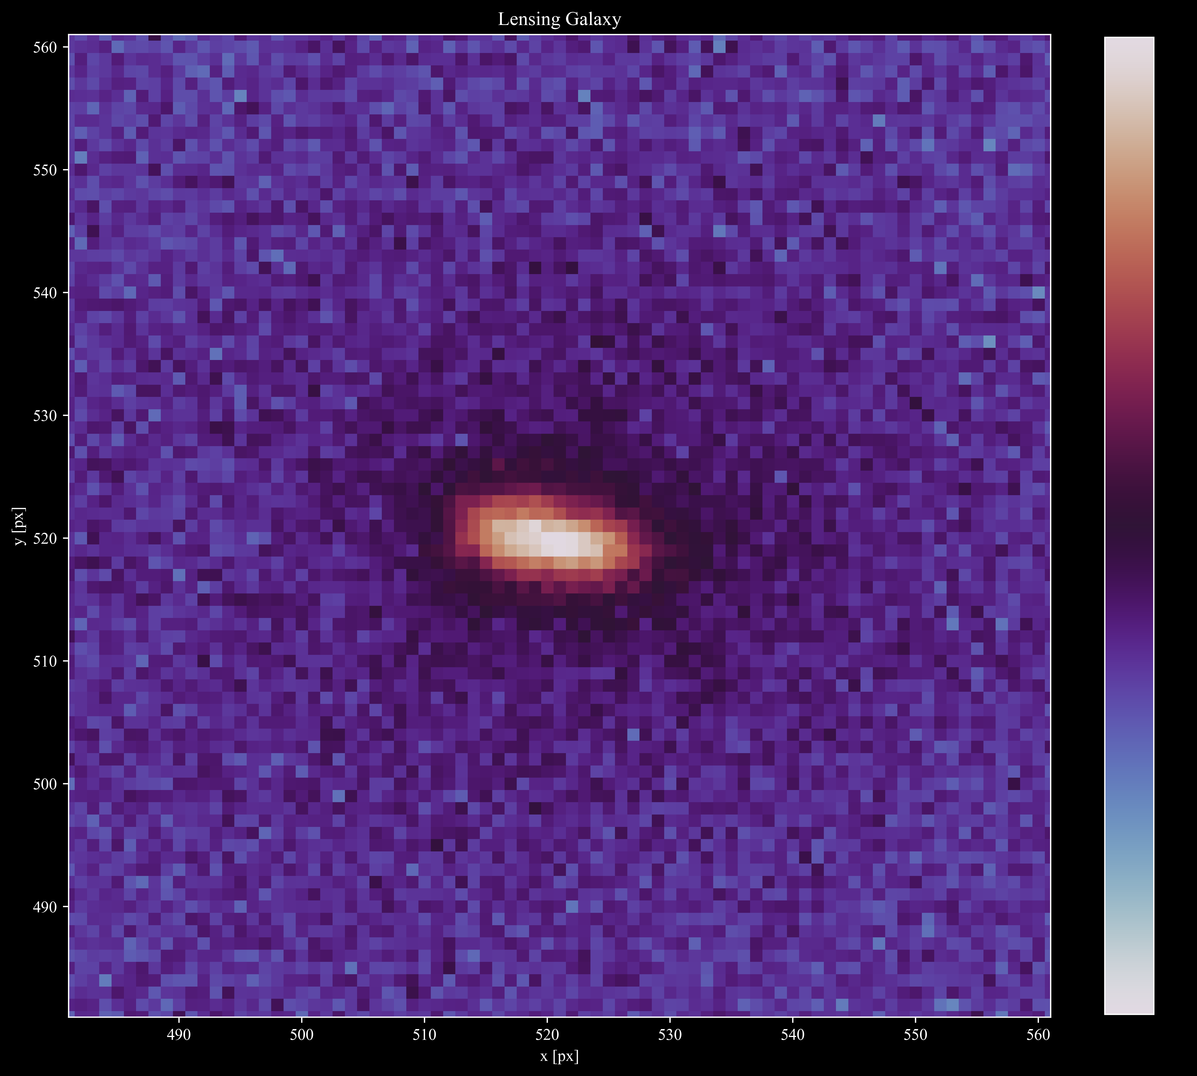
Data

Slide 12
Lens Modelling
CONSTRAINTS:
Positions
Positions and Magnifications
Mass Models:
Single Isothermal Ellipsoidal (SIE)
Power Law (POW)
Navarro Frenk White (NFW)
Einasto (EIN)
Cored Single Isothermal Ellipsoidal (CSIE)
Sersic

Slide 13
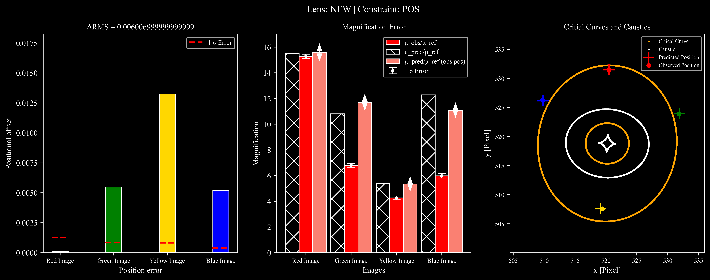
Lens Models

Slide 14
Lens Models

Slide 15
Lens Models

